Slide 1
Data Science Basics in R:
Day 3: Exploratory data analysis

Slide 2
Goals for today
Define descriptive statistics & exploratory data analysis
Create your first data visualization in R
Identify options for visualization in R, including ggplot2
Great creative and have fun exploring datasets

Slide 3
bit.ly/r_basics_day3

Slide 4
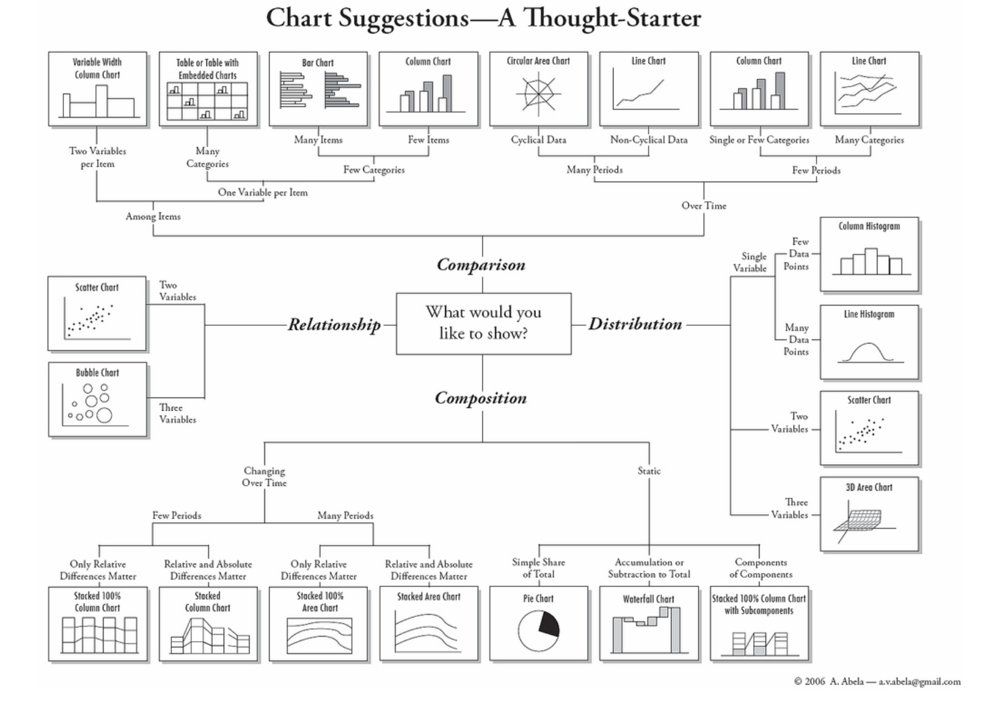
What are you trying to learn?
Graphic by Andrew Abela
https://extremepresentation.typepad.com/blog/2006/09/choosing_a_good.html

Slide 5
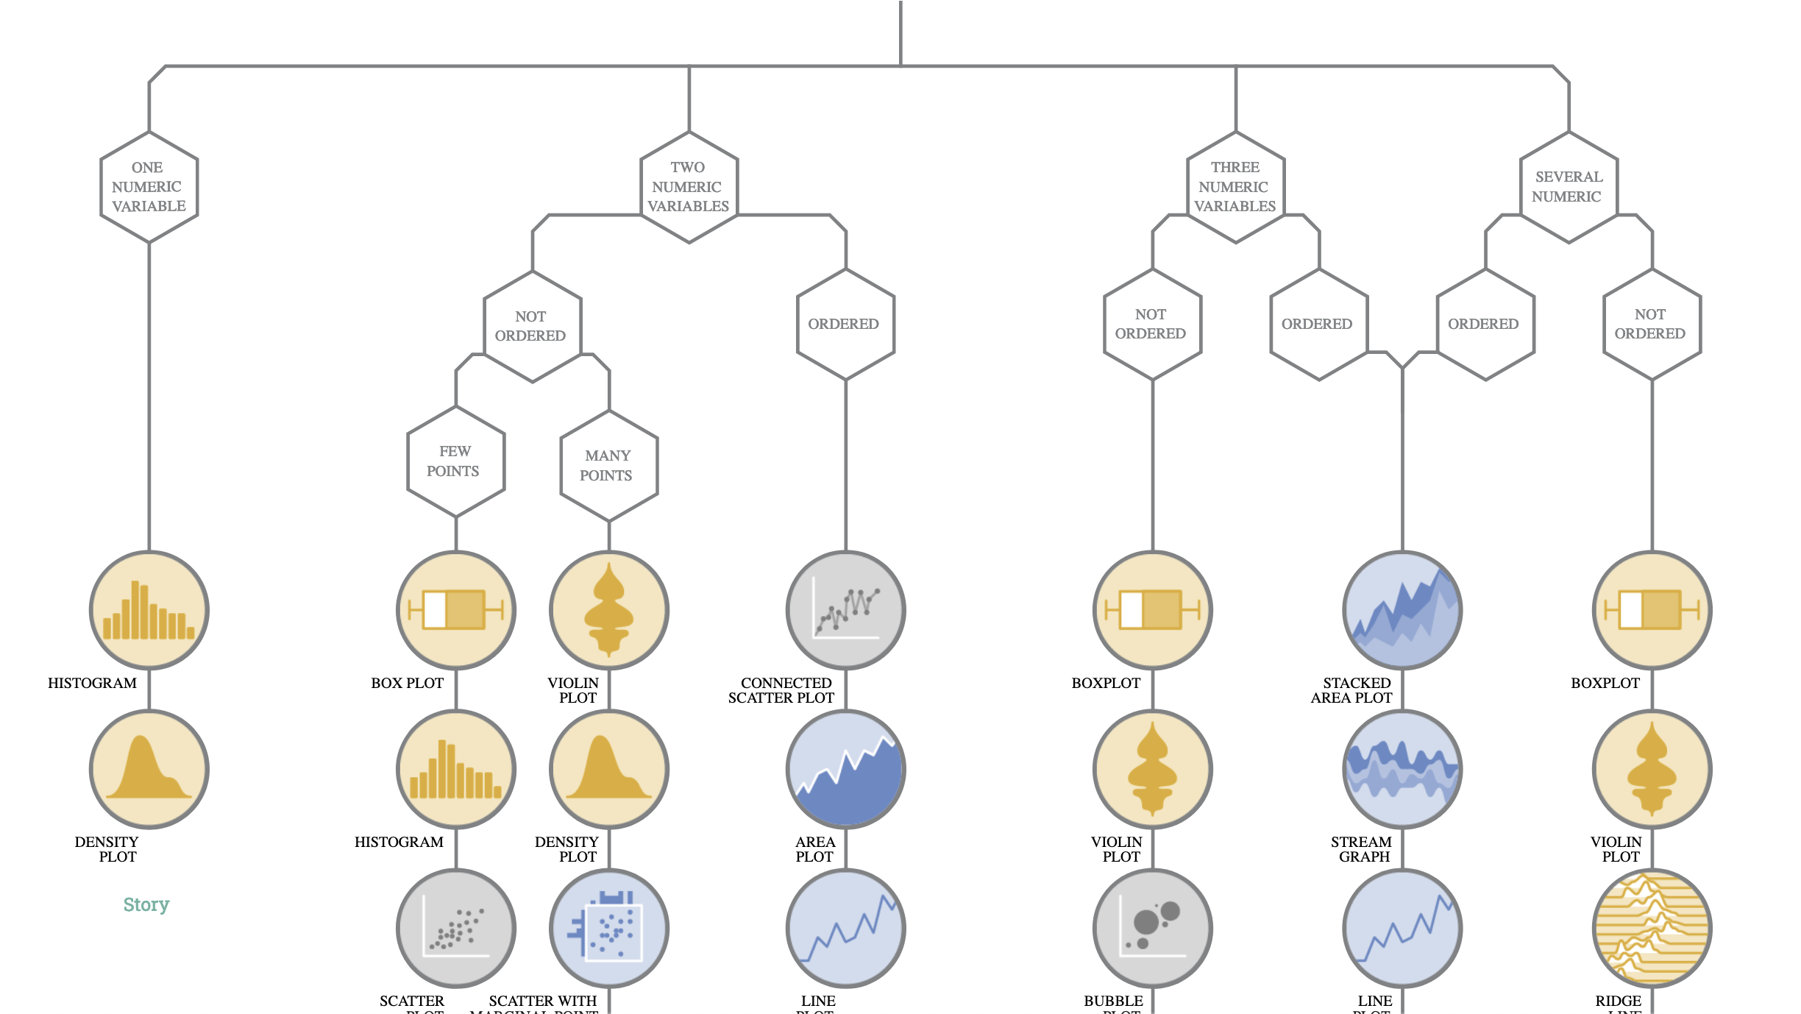
What are you trying to learn?
Graphic by Data to Viz
https://www.data-to-viz.com/

Slide 6
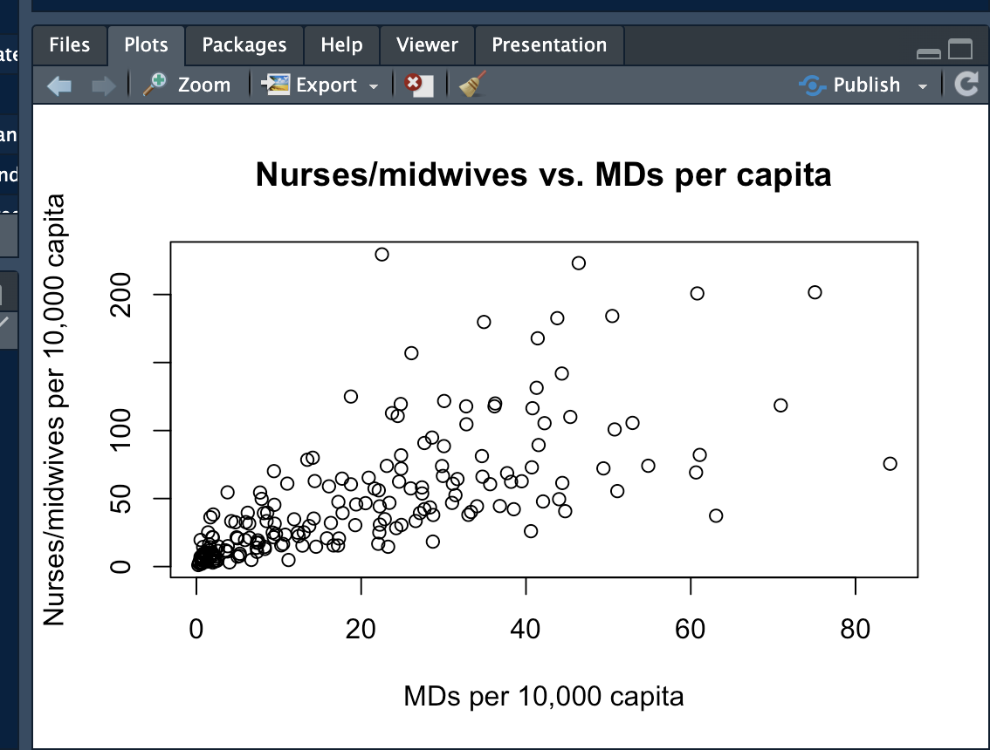
Exporting plots from RStudio

Slide 7
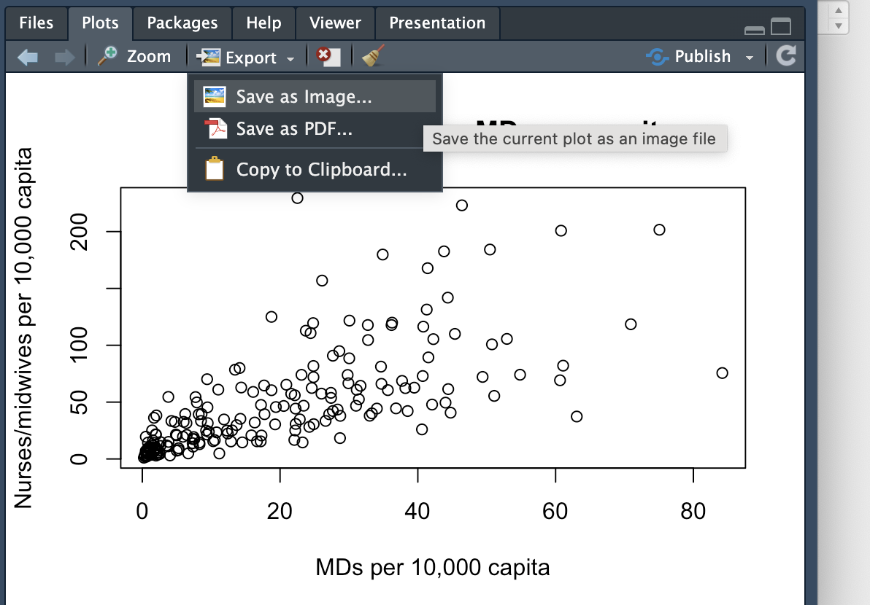
Exporting plots from RStudio

Slide 8
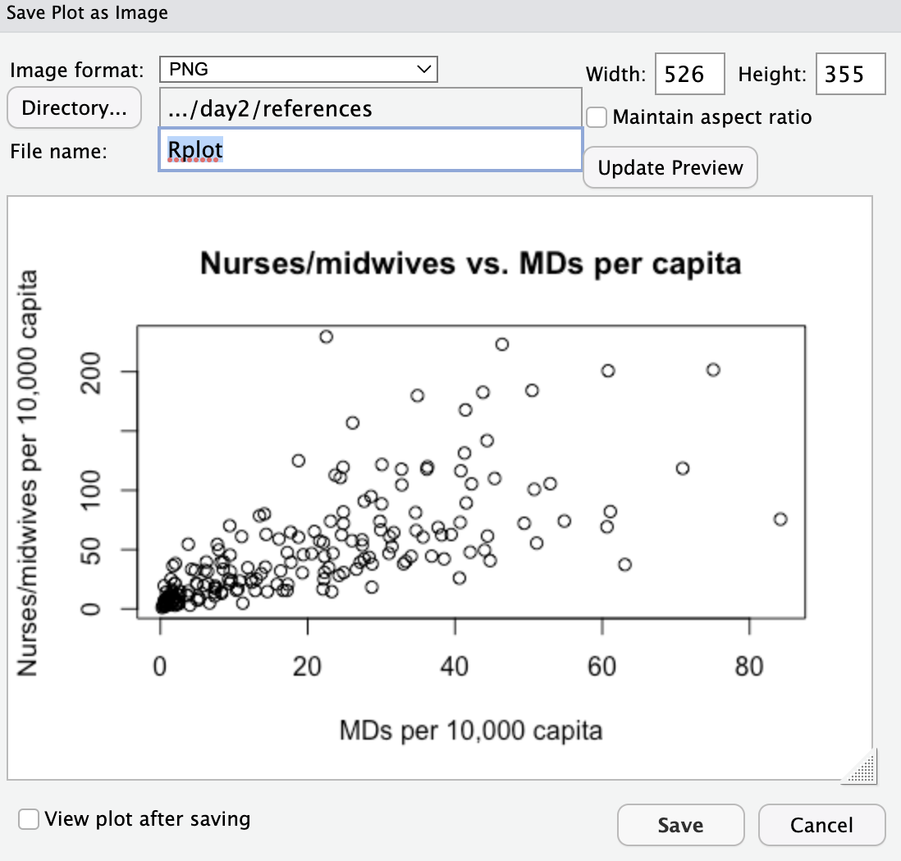
Exporting plots from RStudio
Name your file

Slide 9
Exporting plots from RStudio
Specify where you want to save the file

Slide 10
Exporting plots from RStudio
Adjust dimensions

